Slide 1
5
INVERSE FUNCTIONS

Slide 2
5.4
General Logarithmic and Exponential Functions

Slide 3
General Exponential Functions

Slide 4



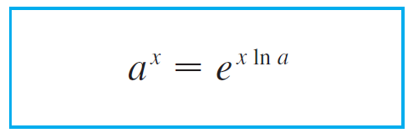


General Exponential Functions
If a > 0 and r is any rational number, then by and
in the previous section,
Therefore, even for irrational numbers x, we define
Thus, for instance,

Slide 5
General Exponential Functions
The function f (x) = a^{x} is called the exponential function with base a.
Notice that a^{x} is positive for all x because e^{x} is positive for all x.
Definition 1 allows us to extend one of the laws of logarithms. We know that ln(a^{r}) = r ln a when r is rational.
But if we now let r be any real number we have, from Definition 1,
ln a^{r} = ln (e^{rlna}) = r ln a

Slide 6

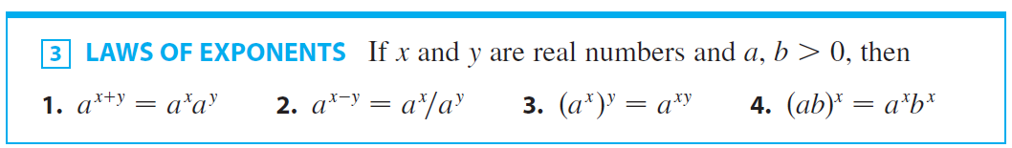
General Exponential Functions
Thus
ln a^{r} = r ln a for any real number r
The general laws of exponents follow from Definition 1 together with the laws of exponents for e^{x}.

Slide 7
PROOF (1)
Using Definition 1 and the laws of exponents for e^{x}, we have:

Slide 8
PROOF (3)
Using Equation 2, we obtain:
The remaining proofs are left as exercises.

Slide 9
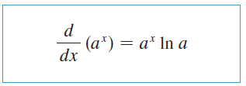
General Exponential Functions
The differentiation formula for exponential functions is also a consequence of Definition 1:
Notice that if a = e, then ln e = 1 and Formula 4 simplifies to a formula that we already know: (d / dx) e^{x} = e^{x}.
In fact, the reason that the natural exponential function is used more often than other exponential functions is that its differentiation formula is simpler.

Slide 10
General Exponential Functions
PROOF:

Slide 11


Example 1
Combining Formula 4 with the Chain Rule, we have

Slide 12
Exponential Graphs

Slide 13
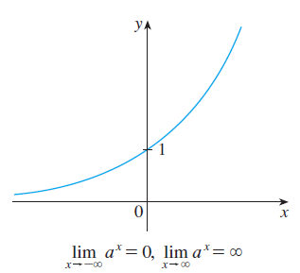
Exponential Graphs
If a > 1, then ln a > 0, so (d / dx) a^{x} = a^{x} ln a > 0, which shows that y = a^{x} is increasing (see Figure 1.)
Figure 1
y = a^{x}, a > 1

Slide 14
EXPONENTIAL GRAPHS
If 0 < a < 1, then ln a < 0.
So, y = a^{x} is decreasing.
See Figure 2.

Slide 15
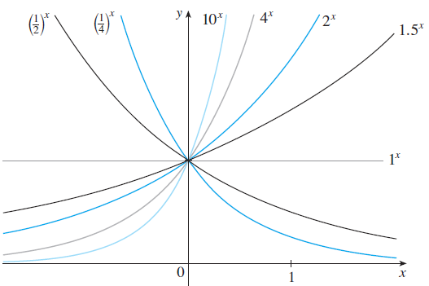
Exponential Graphs
Notice from Figure 3 that as the base a gets larger, the exponential function grows more rapidly (for x > 0).
Members of the family of exponential functions
Figure 3

Slide 16
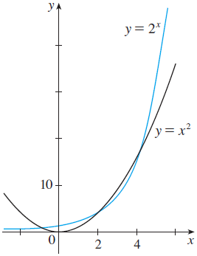
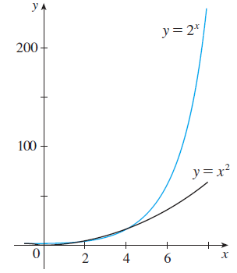
Exponential Graphs
Figure 4 shoes how the exponential function y = 2^{x} compares with the power function y = x². The graphs intersect three times, but ultimately the exponential curve
y = 2^{x} grows far more rapidly than the parabola y = x². (See also Figure 5.)
Figure 4
Figure 5

Slide 17
Exponential Integrals

Slide 18
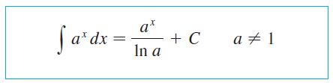
Exponential Integrals
The integration formula that follows from Formula 4 is

Slide 19



Example 2

Slide 20
The Power Rule Revisited

Slide 21

The Power Rule Revisited
Now that we have defined arbitrary powers of numbers, we are in a position to prove the general version of the Power Rule.

Slide 22
THE POWER RULE
PROOF
Let y = x^{n} and use logarithmic differentiation: ln | y | = ln | x |^{n} = n ln | x | x ≠ 0
Therefore,
Hence,

Slide 23
The Power Rule Revisited
To differentiate a function of the from y = [f (x)]^{gx} , where both the base and the exponent are functions, logarithmic differentiation can be used as in the following example.

Slide 24

Example 3
Differentiate

Slide 25

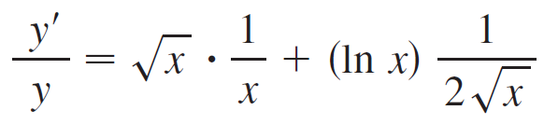
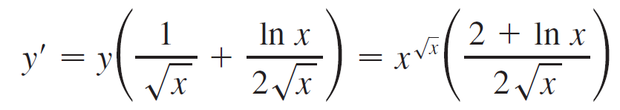
Example 3 – Solution 1
Using logarithmic differentiation, we have

Slide 26

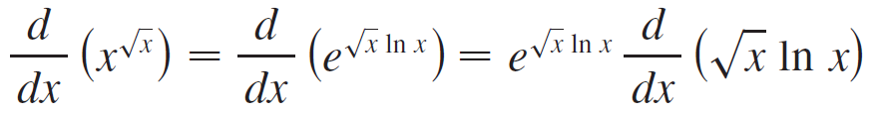
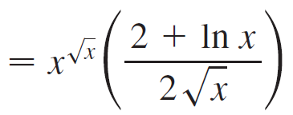
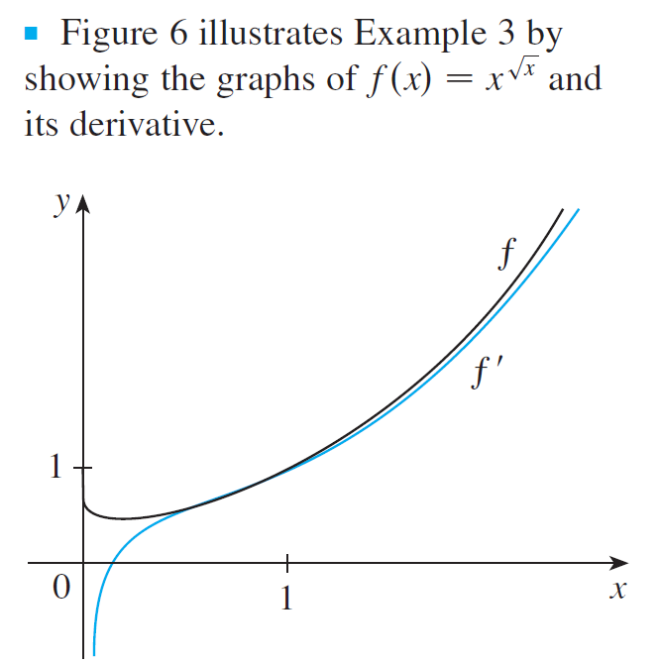
Example 3 – Solution 2
Another method is to write
(as in Solution 1)
Figure 6

Slide 27
General Logarithmic Functions

Slide 28

General Logarithmic Functions
If a > 0 and a 1, then f (x) = a ^{x} is a one-to-one function. Its inverse function is called the logarithmic function with base a and is denoted by log_{a}. Thus

Slide 29


General Logarithmic Functions
In particular, we see that
The cancellation equations for the inverse functions
log_{a}x and a^{x} are

Slide 30
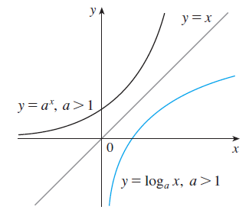
General Logarithmic Functions
Figure 7 shows the case where a > 1. (The most important logarithmic functions have base a > 1.)
The fact that y = a^{x} is a very rapidly increasing function for x > 0 is reflected in the fact that y = log_{a}x is a very slowly increasing function for x > 1.
Figure 7

Slide 31
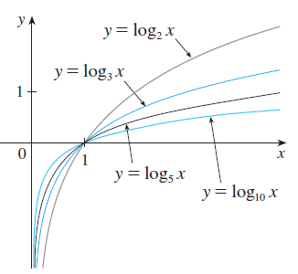
General Logarithmic Functions
Figure 8 shows the graphs of y = log_{a}x with various values of the base a. Since log_{a}1 = 0, the graphs of all logarithmic functions pass through the point (1,0).
Figure 8

Slide 32
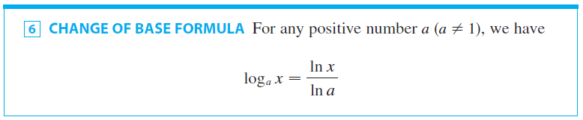
General Logarithmic Functions
The laws of logarithms are similar to those for the natural logarithm and can be deduced from the laws of exponents.
The following formula shows that logarithms with any base can be expressed in terms of the natural logarithm.
Scientific calculators have a key for natural logarithms, so Formula 6 enables us to use a calculator to compute a logarithm with any base. Similarly, Formula 6 allows us to graph any logarithmic function on a graphing calculator or computer.

Slide 33
General Logarithmic Functions
PROOF
Let y = log_{a}x.
Then, from Formula 5, we have a^{y} = x.
Taking natural logarithms of both sides of this equation, we get y ln a = ln x.
Therefore,

Slide 34
Example 4
Evaluate log₈5 correct to six decimal places.

Slide 35

Example 4 - Solution
Formula 6 gives

Slide 36
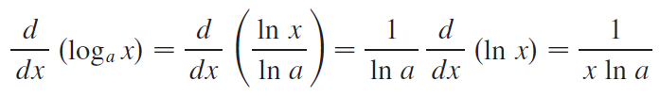
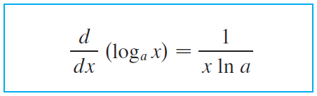

General Logarithmic Functions
Formula 6 enables us to differentiate any logarithmic ln a
function. Since is a constant, we can differentiate
as follows:

Slide 37


Example 5

Slide 38
General Logarithmic Functions
From Formula 7 we see one of the main reasons the
natural logarithms (logarithms with base e) are used in
calculus: The differentiation formula is simplest when
a = e because ln e = 1.

Slide 39
The Number e as a Limit

Slide 40



The Number e as a Limit
We have shown that if f (x) = ln x , then f ′ (x) = 1/x. Thus
f ′ (1) = 1. We now use this fact the express the number e
as a limit.
From the definition of a derivative as a limit, we have

Slide 41

The Number e as a Limit
Because f ′ (1) = 1, we have
Then, by Theorem 1.5.7 and the continuity of the
exponential function, we have

Slide 42


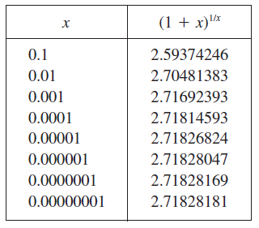
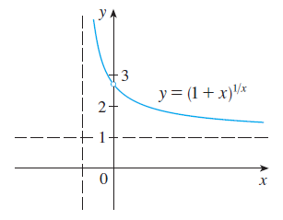
The Number e as a Limit
Formula 8 is illustrated by the graph of the function y = ( 1 + x )^{1/x} in Figure 9 and a table of values for small values of x.
Figure 9

Slide 43
THE NUMBER e AS A LIMIT
If we put n = 1/x in Formula 8, then n → ∞ as x → 0⁺ and so an alternative expression for e is:

